Slide 1


Iterative RBFNN-PSO
Ha-Rang Kim
25.8.24
ⓒSaebyeol Yu. Saebyeol’s PowerPoint

Slide 2
Table of contents
1
Iterative RBFNN
２
RBFNN+PSO

Slide 3
Iterative RBFNN
-The location of the radial basis function in the input space
-Data containing noise or outliers
-The location of the radial basis function in the input space is readjusted using Weighted Fuzzy C-Means(WFCM)
-Since conventional LSE assigns equal importance to all data points, noise and outliers can negatively affect model performance.
To address this, margin maximization is incorporated, combining LSE with LS-SVM to enhance generalization performance.

Slide 4
Iterative RBFNN

Slide 5
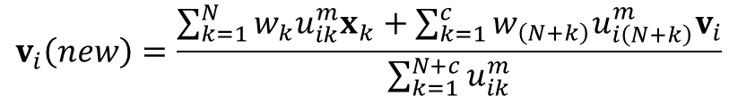
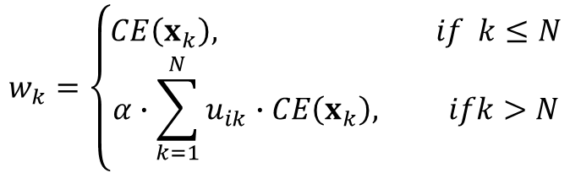

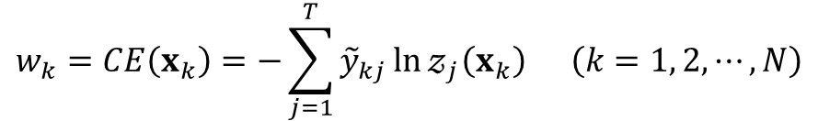
Iterative RBFNN
WFCM
$$w_{k}=CE\left(x_{k}\right)=−\sum_{j=1}^{T}{{\tilde{y}}_{kj}\ln{𝓏_{j}\left(x_{k}\right)}} \left(k=1, 2, ⋯, N\right)$$
$$w_{k}=\left\{\begin{aligned}CE\left(x_{k}\right), if k≤N \\ &α∙\sum_{k=1}^{N}{u_{ik}}∙CE\left(x_{k}\right), ifk>N\end{aligned}\right.$$
$$α\left(0≤α≤1\right)−inertia weight$$
$$v_{i}\left(new\right)=\frac{\sum_{k=1}^{N}{w_{k}u_{ik}^{m}x_{k}}+\sum_{k=1}^{c}{w_{\left(N+k\right)}u_{i\left(N+k\right)}^{m}v_{i}}}{\sum_{k=1}^{N+c}{u_{ik}^{m}}}$$

Slide 6
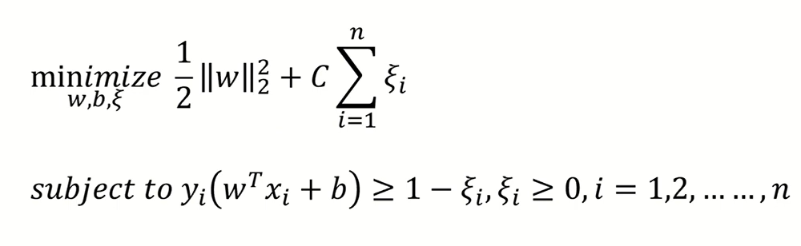
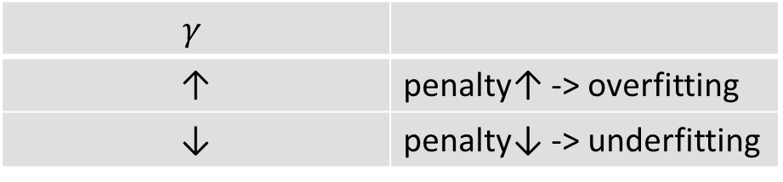

Iterative RBFNN
LS-SVM
$$\min_{a, ξ }{𝒥\left(a,ξ\right)}=\frac{1}{2}a^{T}a+\frac{γ}{2}ξ^{T}ξ s.t. y_{k}\left[φ\left(x_{k}\right)a\right]=1−ξ_{k}$$
$$φ\left(x_{k}\right)=\left[\begin{matrix}u_{k1}{\tilde{x}}_{k} & u_{k2}{\tilde{x}}_{k} & ⋯ & u_{kc}{\tilde{x}}_{k}\end{matrix}\right]∈ℝ^{1×\left(cn+c\right)}$$
$$y_{k}∈\left\{1,−1\right\}$$
$$γ$$
↑ | penalty↑ -> overfitting
↓ | penalty↓ -> underfitting
c
↑ | tolerate error↓ -> margin↓ (hard)
↓ | tolerate error↑ -> margin↑ (soft)

Slide 7
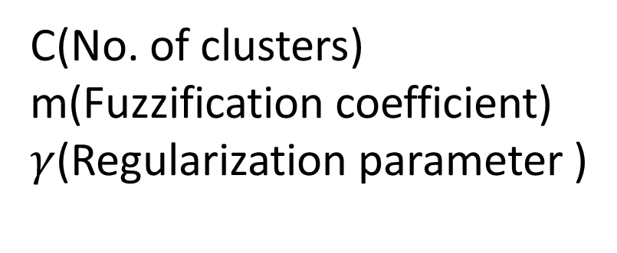
RBFNN+PSO
Algorithm | Parameter | Value
FCM | No. of clusters (c) | 2, 3, 5, 7, 9
 | Fuzzification coefficient (m) | 1.1, 1.5, 2.0, 2.5, 3.0
 | No. of learning iterations | 100
 | Tolerance level (ε) | 1-10
WFCM | Inertia coefficient (alpha) | 0.1, 0.3, 0.5, 0.7, 1.0
 | No. of learning iterations | 100
LS-SVM | Regularization parameter (gamma) | 0.01, 0.1, 1, 10, 100
C(No. of clusters)
m(Fuzzification coefficient)
$γ$(Regularization parameter )

Slide 8
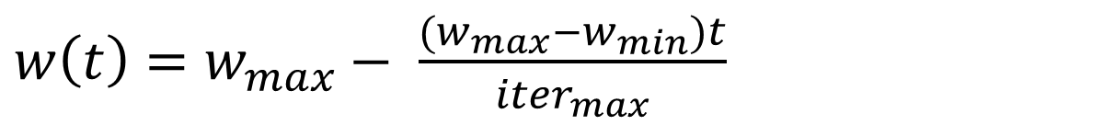
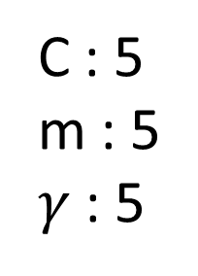
RBFNN+PSO
Grid search
PSO
C : 5
m : 5
$γ$ : 5
5*5*5=125
nparticles : 20
maxIter : 30 (k-fold)
20*30=600
$w\left(t\right)=w_{max}− \frac{(w_{max}−w_{min})t}{{iter}_{max}}$​

Slide 9
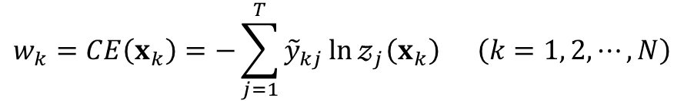

RBFNN+PSO
Objective function : cross-entropy
$$w_{k}=CE\left(x_{k}\right)=−\sum_{j=1}^{T}{{\tilde{y}}_{kj}\ln{𝓏_{j}\left(x_{k}\right)}} \left(k=1, 2, ⋯, N\right)$$
$$Classification rate\left(CR\right)=\left(1−\frac{N_{err}}{N}\right)×100\left(\%\right)$$
Classification Rate often remains unchanged even when parameters are slightly adjusted.
Cross-entropy, when used together with softmax, incorporates probabilistic information and can also be directly applied in weighted fuzzy c-means(wfcm)

Slide 10
RBFNN+PSO
Performance Comparison
데이터 | Iterative RBFNN-PSO |  | Iterative RBFNN
 | Training | Testing | Training | Testing
Australian | 88.94±0.59 | 86.23±4.75 | 88.04±0.53 | 87.68±3.76
balance_data | 91.50±1.19 | 90.25±1.72 | 90.93±0.35 | 90.89±1.45
Forest | 95.03±0.41 | 90.63±2.30 | 93.12±0.35 | 90.82±3.45
Glass | 87.49±1.58 | 70.17±8.28 | 85.05±1.72 | 72.77±10.74
Hayes | 93.01±2.51 | 67.31±16.87 | 91.25±3.07 | 66.70±9.81
Heart | 87.61±1.11 | 83.33±5.86 | 85.60±0.61 | 85.19±4.62
Ionosphere | 97.18±0.38 | 91.16±3.44 | 95.89±0.70 | 92.58±4.52
Iris | 98.07±0.38 | 97.33±4.66 | 98.07±0.38 | 98.00±3.22
Leaf | 93.43±1.11 | 74.71±3.72 | 95.52±0.89 | 79.71±5.09
Libras | 99.85±0.16 | 80.83±6.20 | 99.88±0.16 | 78.06±5.31
Seeds | 98.20±0.76 | 96.67±3.21 | 96.88±0.46 | 96.67±3.92
Sonar | 100.00±0.00 | 87.951±6.16 | 100.0±0.0 | 88.48±6.82
WDBC | 99.49±0.17 | 97.36±2.78 | 98.69±0.28 | 98.24±1.85
Wine | 100.00±0.00 | 98.86±2.41 | 100.0±0.0 | 99.44±1.76
Zoo | 100.0±0.0 | 97.00±6.75 | 100.0±0.0 | 98.00±6.32

Slide 11
RBFNN+PSO
Improvement Directions
Fold Configuration with Validation Set
(Each fold is divided into training, validation, and test sets in a 5:4:1 ratio )
PSO-based Parameter Estimation
α\alphaα is also estimated with PSO (ignore computation cost)
Experiment by varying the values of C and W
(Reducing the number of particles and iterative)
PSO Settings
Inertia weight (w)
Cognitive coefficient (c1​)
Social coefficient (c2)
(Number of particles, Number of iterations)

